Slide 1
Real-Time Asteroid Detection & Analytics Pipeline
Using NASA NEO API, Kafka, Spark Structured Streaming, HDFS, InfluxDB, Grafana
Name: Vishnu Muralikrishnan
Program: ESILV – MCS Computer science and data science
Year: 2026

Slide 2
Problem Statement
Near-Earth Objects (NEOs) pose potential risks
NASA provides asteroid data, but:
  Data is batch-oriented
  No real-time analytics
Goal:
Build a real-time, fault-tolerant data pipeline to ingest, process, store, and visualize asteroid metrics

Slide 3
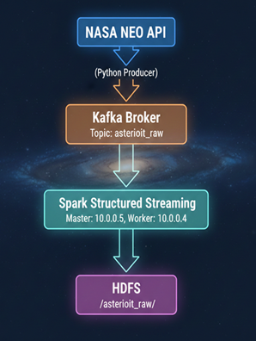
High-Level Architecture
Pipeline Flow:
NASA NEO API → Kafka Producer
Kafka → Spark Structured Streaming
Spark → HDFS (raw data)
Spark → InfluxDB (aggregated metrics)
Grafana → Real-time dashboards

Slide 4
Technologies Used
Kafka – real-time ingestion
Apache Spark Structured Streaming – processing & aggregation
HDFS – durable raw storage
InfluxDB – time-series metrics storage
Grafana – visualization

Slide 5
Design Choices
Why Kafka?
Decouples ingestion from processing
Handles bursts from NASA API
Replay capability
Why Spark Structured Streaming?
Exactly-once semantics
Windowed aggregations
Native Kafka integration

Slide 6
Design Choices
Why InfluxDB?
Optimized for time-series data
Efficient aggregation queries
Grafana native support

Slide 7
Fault Tolerance
Kafka
Message durability
Consumer offsets stored reliably
Spark
Checkpointing used for:
  Kafka offsets
  Streaming state
Automatic recovery on failure
HDFS
Replicated storage for raw data

Slide 8
Infrastructure Configuration
Show which VM is master, which is worker, and which service runs on each.
Component | Role | Host/IP:Port | Notes
HDFS NameNode | Master | 10.0.0.5:9870 | Master VM
HDFS DataNode | Worker | 10.0.0.4:9864 | Worker VM
Spark Master | Master | 10.0.0.5:7077, UI: 8080 | Running
Spark Worker | Worker | 10.0.0.4 | Running
Kafka Broker | Master | 10.0.0.5:9092 | Single broker
Topic: asteroid_raw | Kafka | master:9092 | Created

Slide 9
HDFS Directory Listing

Slide 10
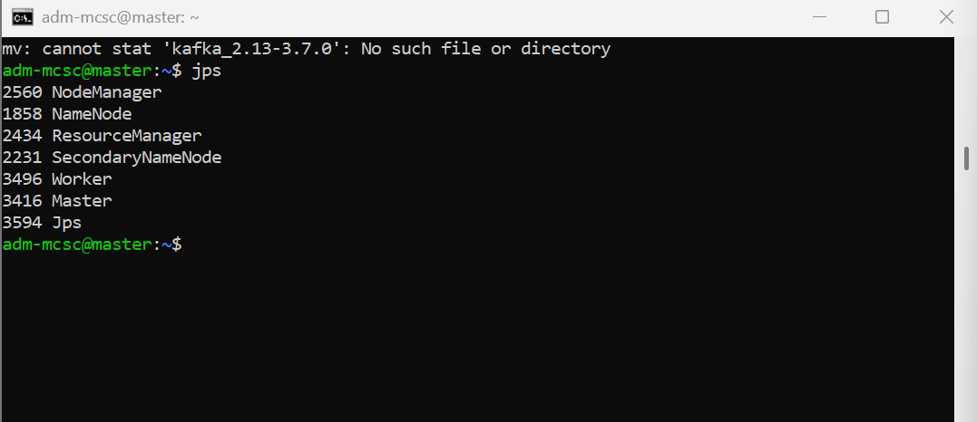
Master jps

Slide 11
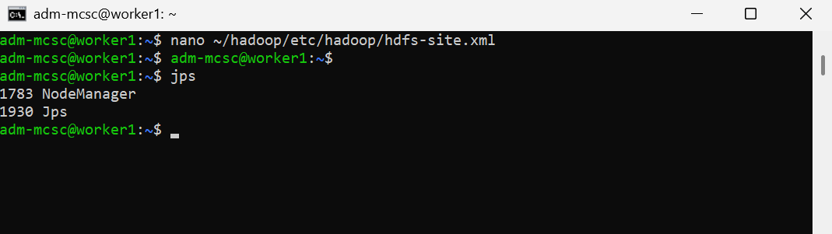
Worker jps

Slide 12
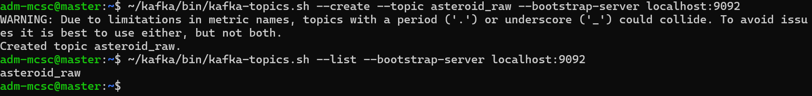
Kafka Topic Created

Slide 13
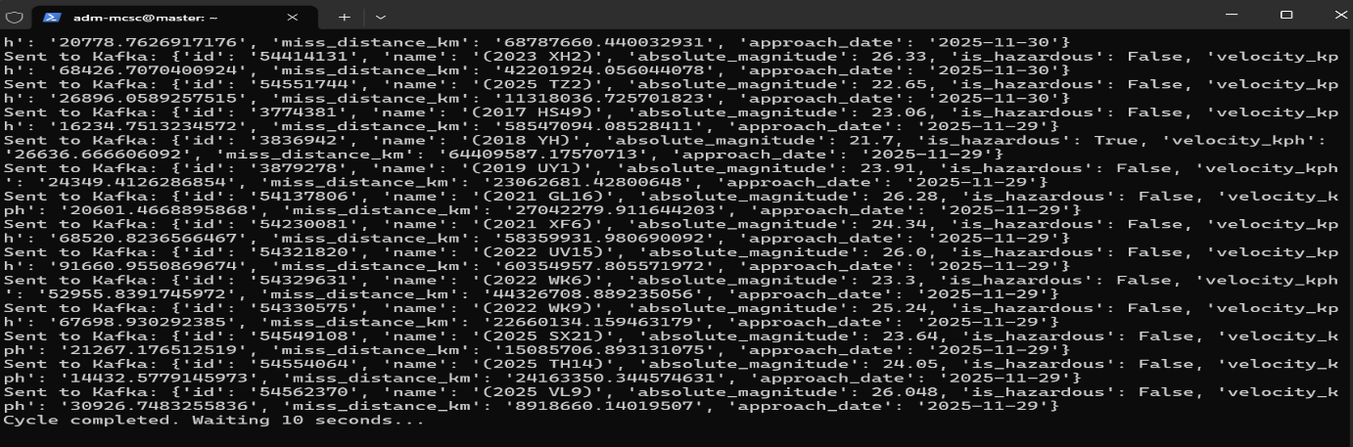
Producer Running (Sending Messages)

Slide 14
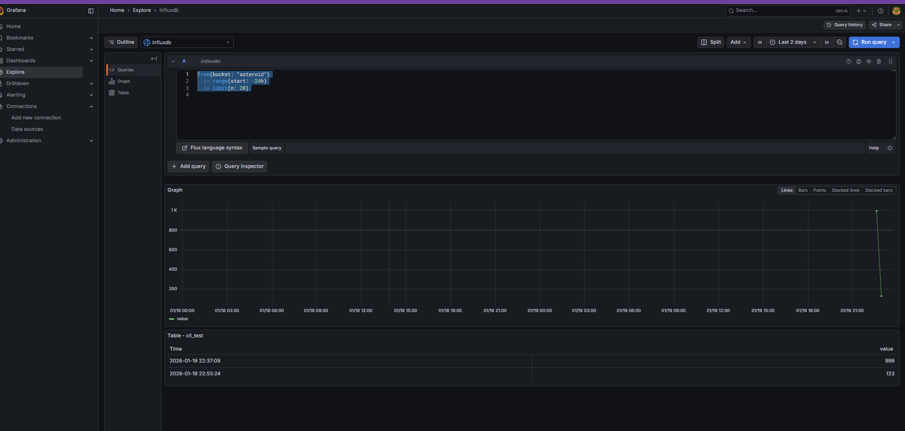
Dashboard (Grafana)

Slide 15
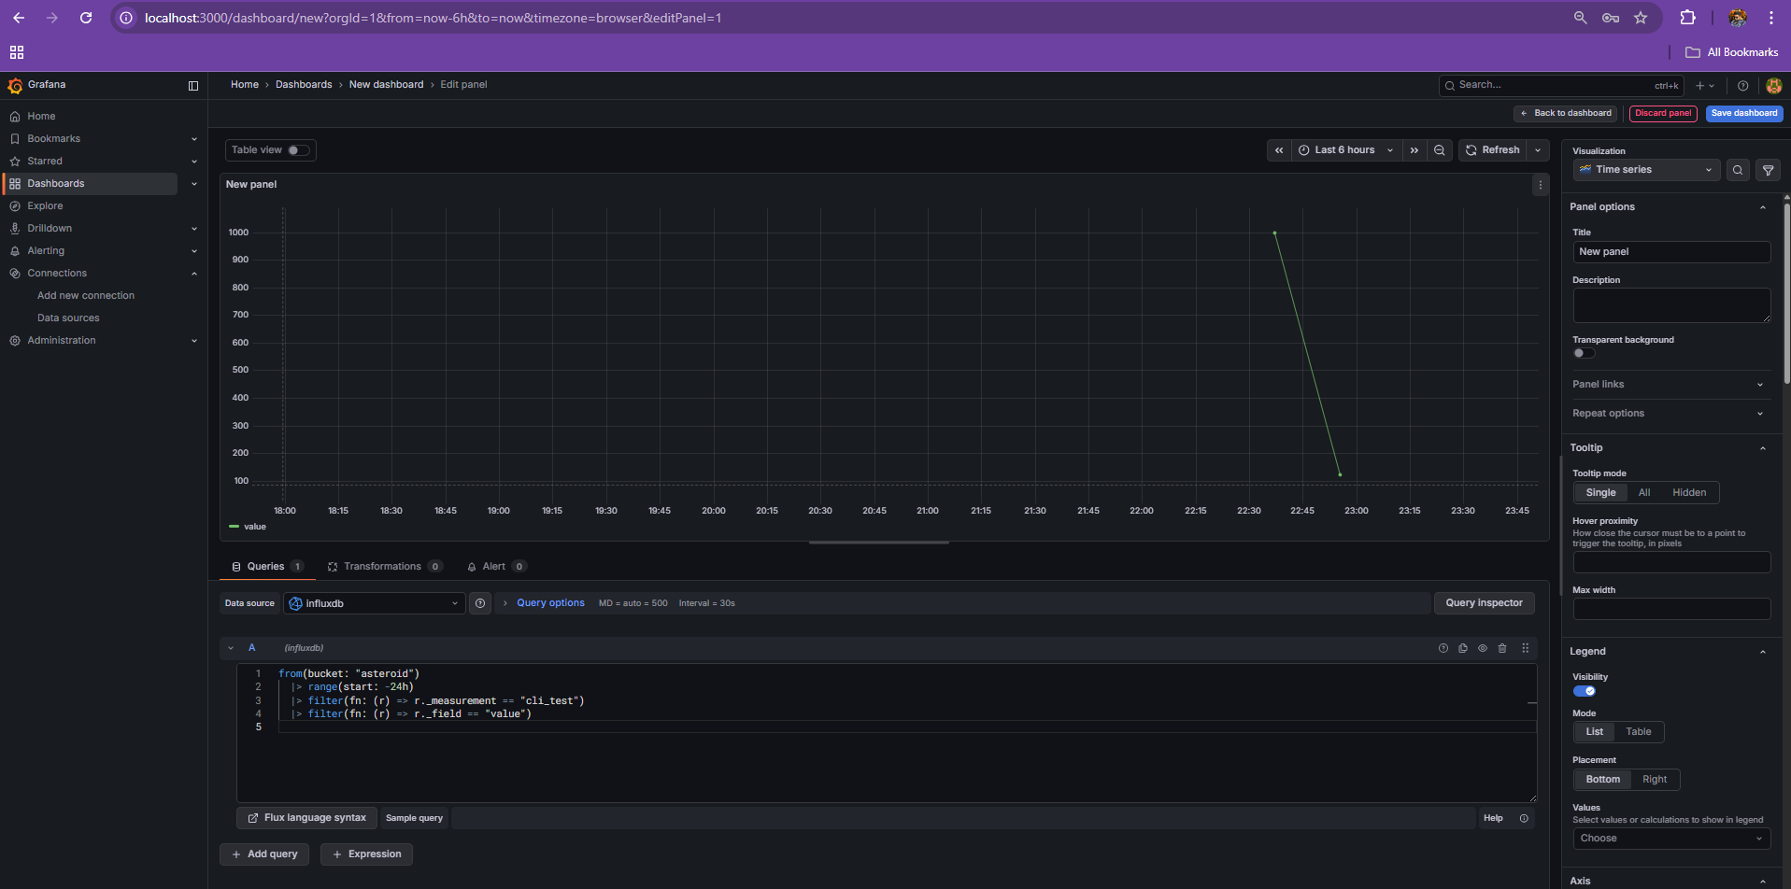

Slide 16
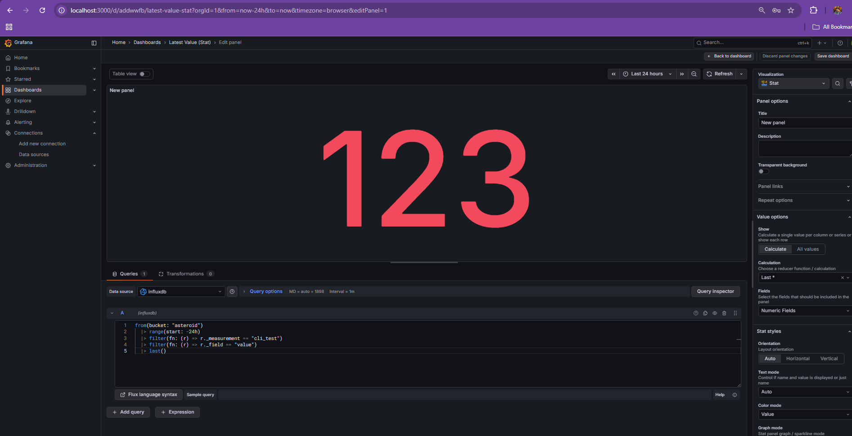

Slide 17
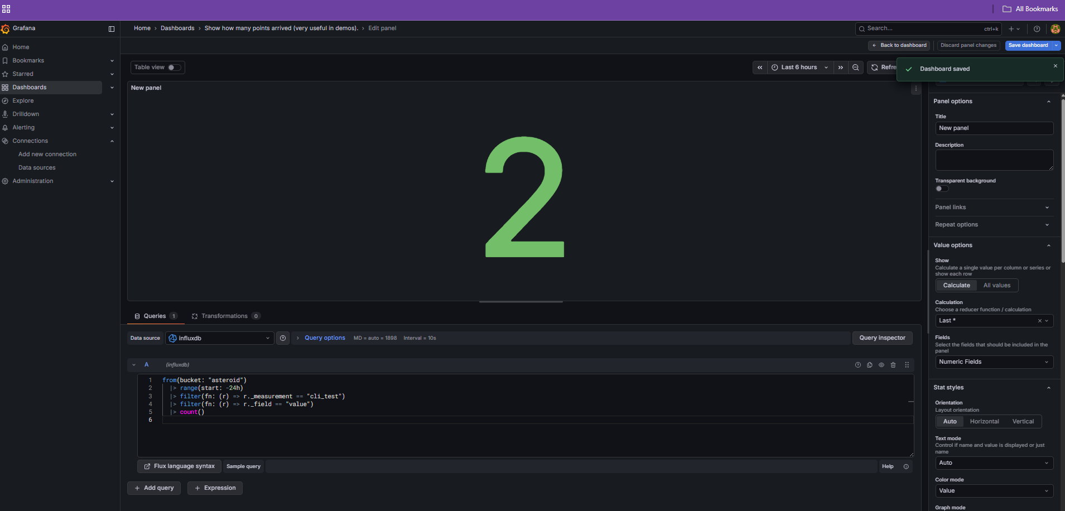

Slide 18
Challenges Faced
Kafka broker instability
Spark master connection issues
InfluxDB authentication (tokens)
Streaming job restarts
Schema mismatches
Debugging distributed systems

Slide 19
Lessons Learned
Importance of observability
CLI verification before UI
Streaming ≠ batch thinking
Small mistakes propagate fast in pipelines
Proper environment configuration is critical

Slide 20
Conclusion
Built a fully working real-time analytics pipeline
Demonstrated scalability and fault tolerance
Applicable to real-world streaming use cases
Strong foundation for production-grade systems

